Slide 1
Predicate Logic Conti….
Professor Dr. A K M Akhtar Hossain
Dept. of CSE, RU.

Slide 2
Properties of Statements:
Satisfiable: A statement is satisfiable if there is some interpretation for which it is true.
Contradiction: A sentence is contradictory (unsatisfiable) if there is no interpretation for which, it is true.
Valid: A sentence is valid if it is true for every interpretation.
Equivalence: Two sentences are equivalent if they have the same truth value under every interpretations.
© Professor Dr. A. K. M. Akhtar Hossain, Dept. of CSE, University of Rajshahi

Slide 3
Conti…
Logical Consequences: A sentence is a logical consequence of another if it is satisfied by all interpretations which satisfy the first.
A valid statement is satisfiable, and a contradictory statement is invalid, but the converse is not necessarily true.
© Professor Dr. A. K. M. Akhtar Hossain, Dept. of CSE, University of Rajshahi

Slide 4
Example: On The above definitions:
P is satisfiable but not valid since an interpretation that assigns false to P assigns false to the sentence P.
P V ~P is valid since every interpretation results in a value of true for (P V ~P ).
P & ~P is a contradiction since every interpretation results in a value of false for (P & ~P).
© Professor Dr. A. K. M. Akhtar Hossain, Dept. of CSE, University of Rajshahi

Slide 5
Conti…
P and ~(~P) are equivalent since each has the same truth values under every interpretation.
P is a logical consequence of (P & Q) since any interpretation for which (P & Q) is true, P is also true.
© Professor Dr. A. K. M. Akhtar Hossain, Dept. of CSE, University of Rajshahi

Slide 6
Theorem
Theorem 4.1: The sentence s is a logical consequence of s₁ , s₂ , ...... , s_{n} if and only if s₁ & s₂ & s₃ . . . . & s_{n} → s is valid.
Proof: Theorem 4.1 can be seen by first noting that if s is a logical consequence of s₁ , s₂ , .......... , s_{n} , then for any interpretation I in which s₁ & s₂ & s₃ , ..... . &s_{n} → s is true.
on the other hand, if s₁ & s₂ & s₃ , .... & s_{n} →s is valid, then for any interpretation I if s₁ & s₂ & s₃ , ..... . &s_{n} is true, s is also true.
© Professor Dr. A. K. M. Akhtar Hossain, Dept. of CSE, University of Rajshahi

Slide 7
Theorem
Theorem 4.2: The sentence s is a logical consequence of s₁ , s₂ , ...... , s_{n} if and only if s₁ & s₂ & s₃ , .... & s_{n} & ~s is inconsistent.
Proof: The proof of theorem 4.2 follows directly from theorem 4.1 since s is a logical consequence of s₁ , s₂ , ...... , s_{n} if and only if s₁ & s₂ & s₃ , ..... . &s_{n} → s is valid, that is, if and only if ~(s₁ & s₂ & s₃ , ..... . &s_{n} → s ) is inconsistent.
© Professor Dr. A. K. M. Akhtar Hossain, Dept. of CSE, University of Rajshahi

Slide 8
Conti …..
But
~(s₁ & s₂ & s₃ , ..... . &s_{n} → s ) = ~(~(s₁ & s₂ & s₃ , ..... . &s_{n} ) V s )
[By Conditional Elimination]
= ~~(s₁ & s₂ & s₃ , ..... . &s_{n} ) & ~s)
[ By De Morgan’s Law]
= s₁ & s₂ & s₃ , ..... . &s_{n} & ~s
When s is a logical consequence of s₁ , s₂ , ...... , s_{n} , the formula s₁ & s₂ & s₃ , ..... . &s_{n} → s is called a theorem, with s is the conclusion.
When s is a logical consequence of the set S = {s₁ , s₂ , ...... , s_{n} } we will also set S logically implies or logically entails S , written Sⱶs .
© Professor Dr. A. K. M. Akhtar Hossain, Dept. of CSE, University of Rajshahi

Slide 9
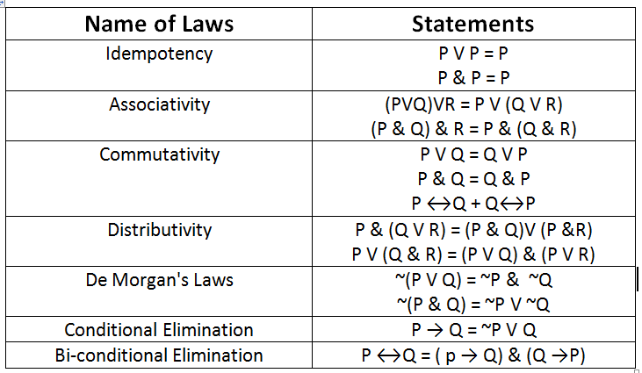
Table 4.2 lists some of the important laws of PL (Some Equivalence Laws)
© Professor Dr. A. K. M. Akhtar Hossain, Dept. of CSE, University of Rajshahi

Slide 10
Example
Show that P→Q is equivalent to ~PVQ and that P↔Q is equivalent to the expression (P→Q)&(Q→P).
The truth table 4.3 is given bellow.
© Professor Dr. A. K. M. Akhtar Hossain, Dept. of CSE, University of Rajshahi

Slide 11
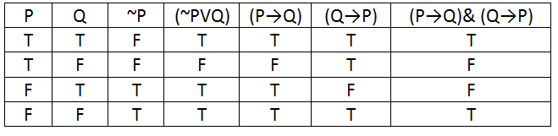
TABLE 4.3 : Truth table for equitant sentences
© Professor Dr. A. K. M. Akhtar Hossain, Dept. of CSE, University of Rajshahi

Slide 12
Inference Rules
The inference rules of PL provide the means to perform logical proofs or deductions.
Few Such Rules are as follows:
  Modus ponens
  Chain Rule
© Professor Dr. A. K. M. Akhtar Hossain, Dept. of CSE, University of Rajshahi

Slide 13
Modus Ponens:
From P and P → Q infer Q. This sometimes written as
P
P → Q
Q
© Professor Dr. A. K. M. Akhtar Hossain, Dept. of CSE, University of Rajshahi

Slide 14
Example For Modus Ponens:
Given: (Joe is a father)
And: (Joe is a father) → ( Joe has a child)
Conclude: (Joe has a child)
© Professor Dr. A. K. M. Akhtar Hossain, Dept. of CSE, University of Rajshahi

Slide 15
Chain Rule
Form P → Q and Q→ R, infer P→R.
Or
P → Q
Q → R
P → R
© Professor Dr. A. K. M. Akhtar Hossain, Dept. of CSE, University of Rajshahi

Slide 16
Example for Chain Rule
Given: (programmer likes LISP)→ (programmer hates COBOL)
and : (programmer hates COBOL) → (programmer likes recursion)
Conclude: (programmer likes LISP)→ (programmer likes recursion)
LISP → List Processing
COBOL → Common Business Oriented Language
Prolog → Programming in Logic
© Professor Dr. A. K. M. Akhtar Hossain, Dept. of CSE, University of Rajshahi

Slide 17
Assignment-2
Construct a truth Table for the expression
(A & (A V B)).
© Professor Dr. A. K. M. Akhtar Hossain, Dept. of CSE, University of Rajshahi

Slide 18
Thanks
© Professor Dr. A. K. M. Akhtar Hossain, Dept. of CSE, University of Rajshahi

